Slide 1
Bug Tracking System
Batch: WFS-4 (TEAM 1)
Team Name: Runtime Terror
Team members:
Adrija Ghansiyal (Team lead)
Abhijeet Nitin Raut
Akanksha Shrivastava
Akshay Ramdev
Ankit D.S Bhadoriya
Bharadwaj Divate Kondandarama
Dharampreet Singh
Gautami Ravindra Rahane
Hrishita Bhattacharjee
Hrushikesh Vitthal Vanga

Slide 2
Team Members :-
Abhijeet Nitin Raut-Implemented import users module as per the functionality requirement of the project. Also, designed the frontend and the test cases for the project.
Adrija Ghansiyal-Implemented the base structure of the database as per the functionality requirement of the project. This was followed by the debugging process of different modules and their integration to form the main system.
Akanksha Shrivastava-Implemented the bean classes, display all projects and display all bugs functionalities for the project and also did the project cleaning for better presentation.
Akshay Ramdev-Implemented the registration process module for the project. Also, worked on developing the frontend for the project.
Ankit D.S Bhadoriya-Implemented registration process module as per the functionality requirement of the project and worked on improving error handling in registration and user process modules.
Bharadwaj Divate Kondandarama-Implemented the functionalities for tester section of the project, designed data flow diagrams for better understanding of different modules.
Dharampreet Singh-Implemented the functionalities of the project manager module, worked on improving error handling in user process modules.
Gautami Ravindra Rahane-Implemented the functionalities for developer section of the project and designed data flow diagrams for better understanding of different modules.
Hrishita Bhattacharjee-Implemented create new project by the project manager module, assigning team members to the project and worked on improving error handling in user process modules.
Hrushikesh Vitthal Vanga-Implemented the login and user validation module for the project. Also, designed the frontend for the project.

Slide 3
Application Features :-
On clicking logout button
Bug Tracker Home Page
On clicking logout button
On clicking logout button
Login-For registered users to login and depending on the role, displays the corresponding page.
Import users-Imports users from a json file and stores the details in the database.
Login-For a registered user to login and depending on the role, the corresponding page is displayed.
Register-For a new user to register into the system. Allowed only for imported users
Register-Displays a form to register a new user.
Project Manager Main Page-Displays user's details.
Import users
Tester Main Page-Displays user's details.
Developer Main Page-Displays user's details
If Project Manager clicks on create project button
If Project Manager clicks on project details button
If tester clicks on assigned projects button.
If developer clicks on view projects button.
Assigned Projects-Displays a list of projects assigned to the tester, with a link to report a new bug.
View Projects-Displays a list of projects assigned to the developer, alongwith a link to view bugs.
Create Project-UI to create a new project and assign team members to the project.
Project Details-Displays the list of projects under them. Project link displays its details and the tasks to be performed on bugs.
If tester clicks on report bug link.
If developer clicks on view bugs link.
View Bugs-Displays list of bugs under that project and the developer can mark a bug for closing.
UI to enter the bug details and report the bug.

Slide 4
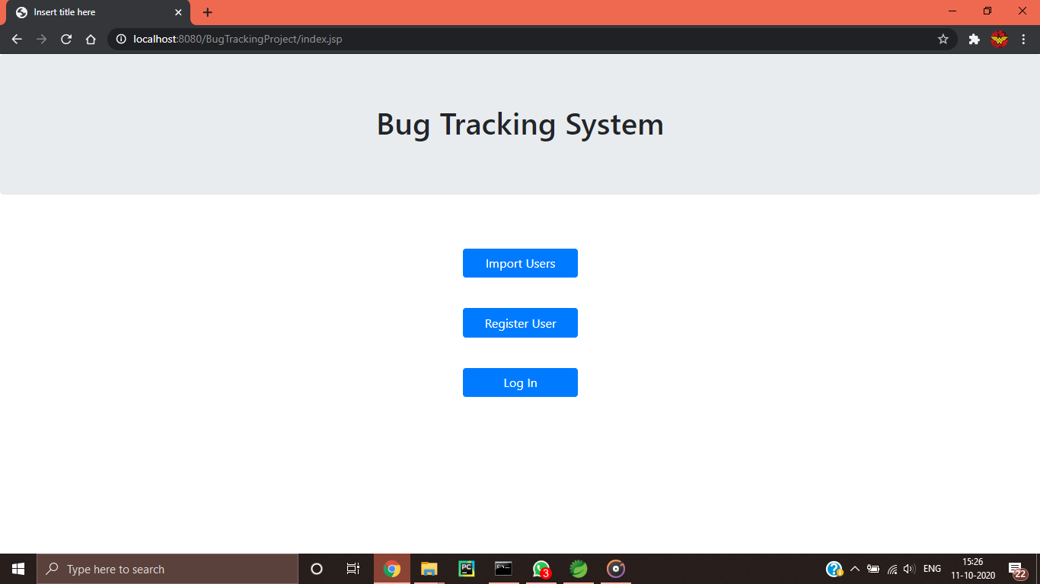
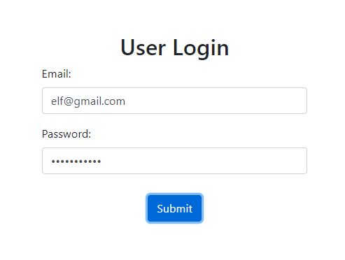
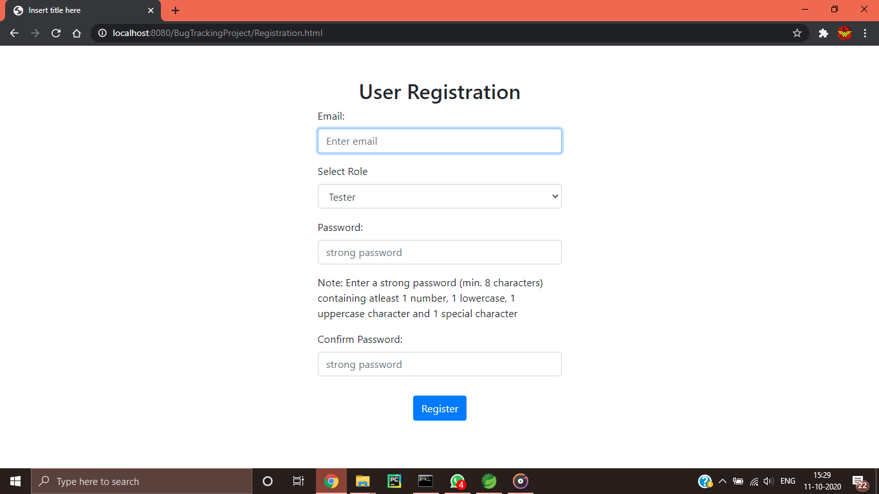
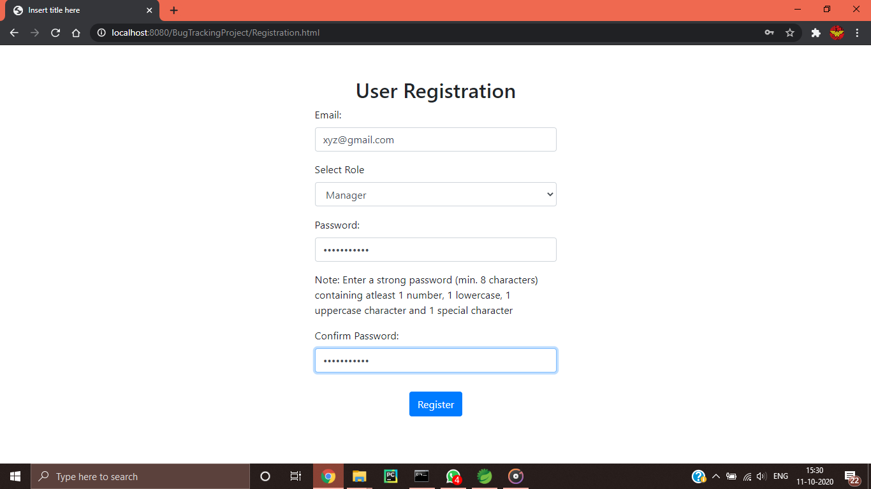
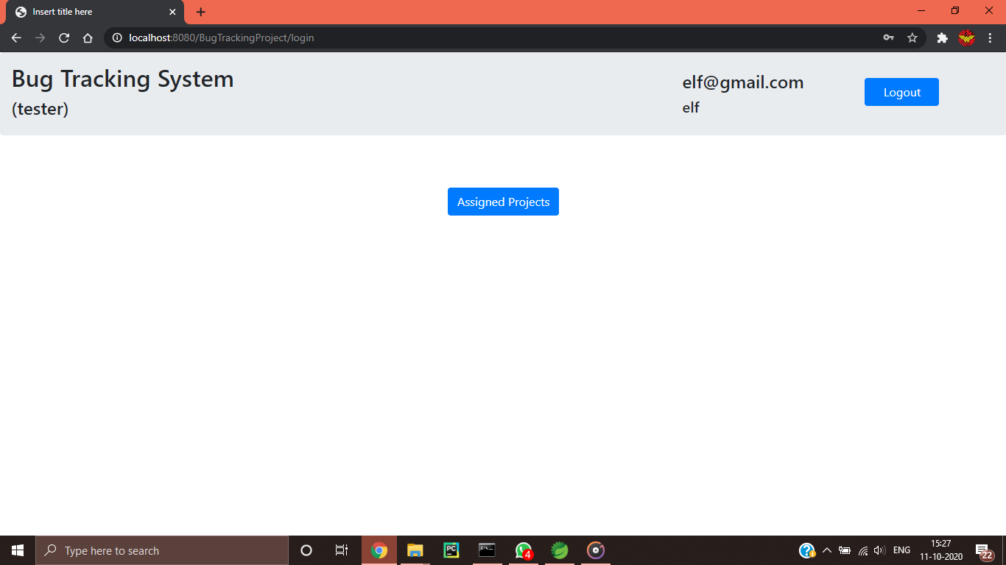
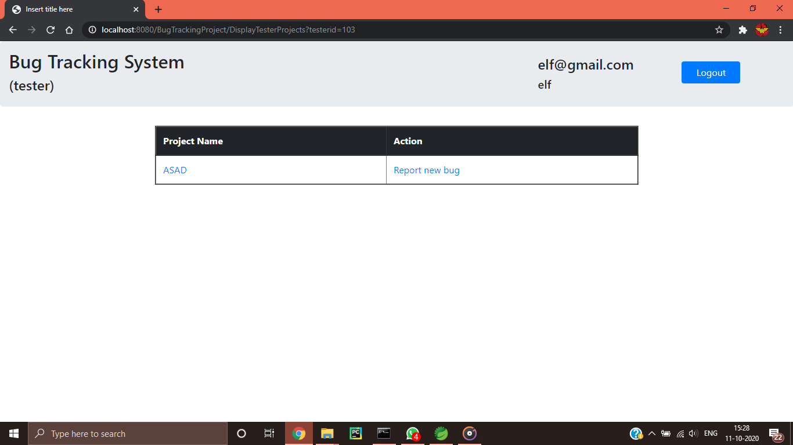
UI Snapshots:-
Homepage
User login page
New user registration page
Password specifications
Tester Home Page
List of projects under the tester

Slide 5
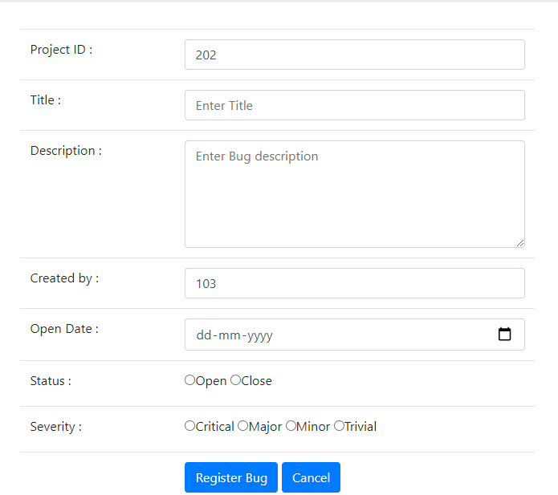
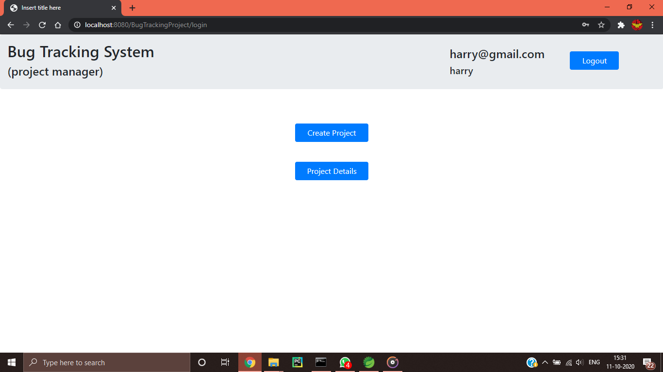
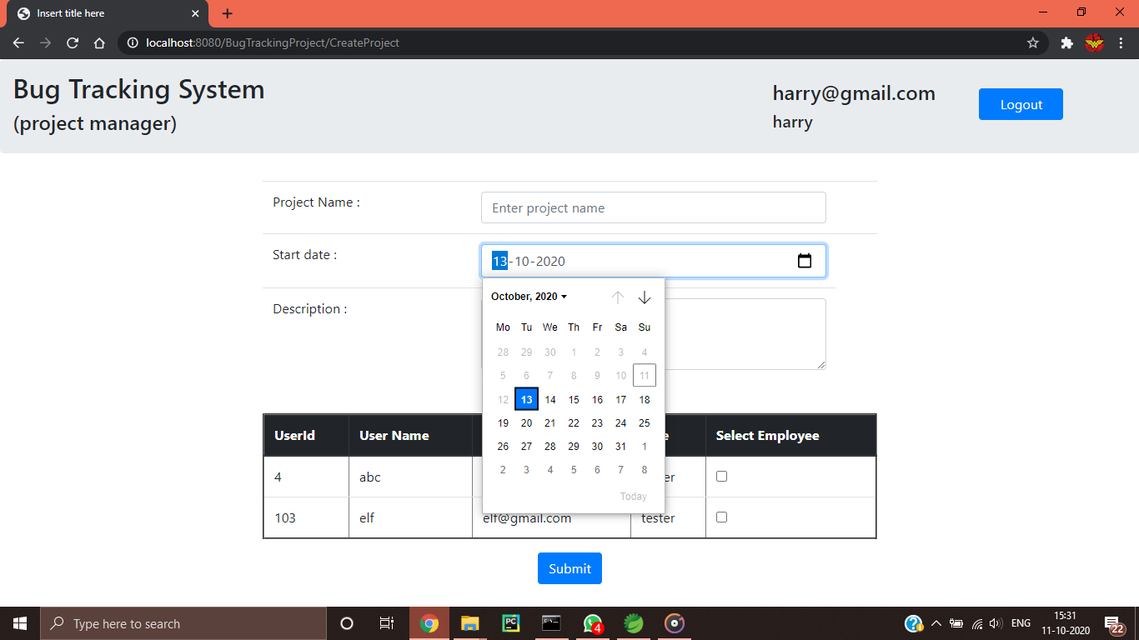
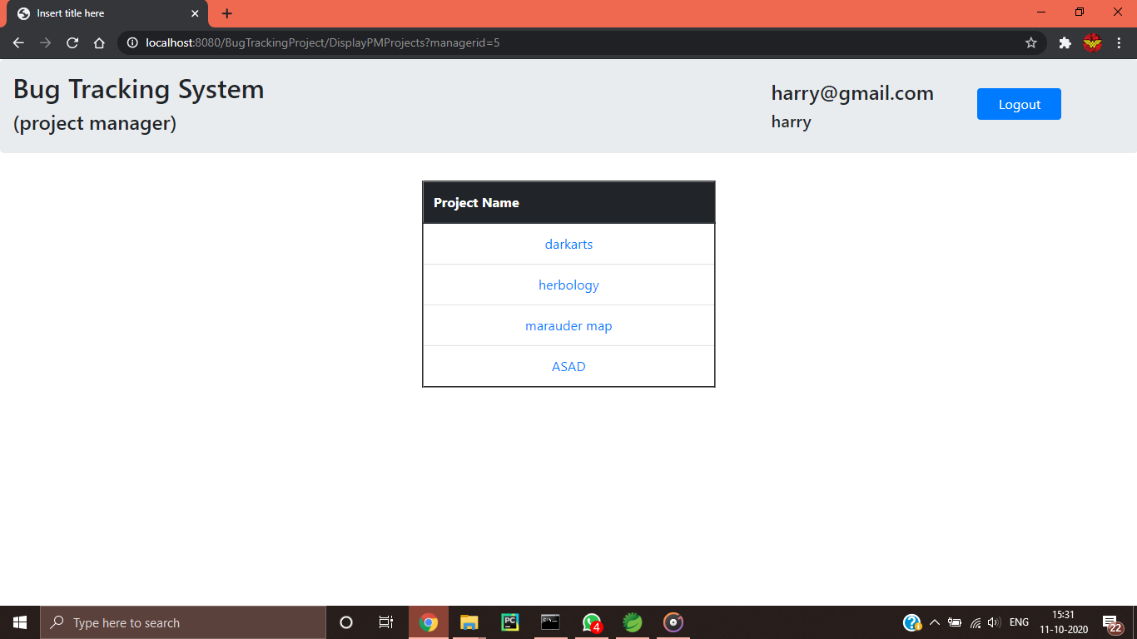
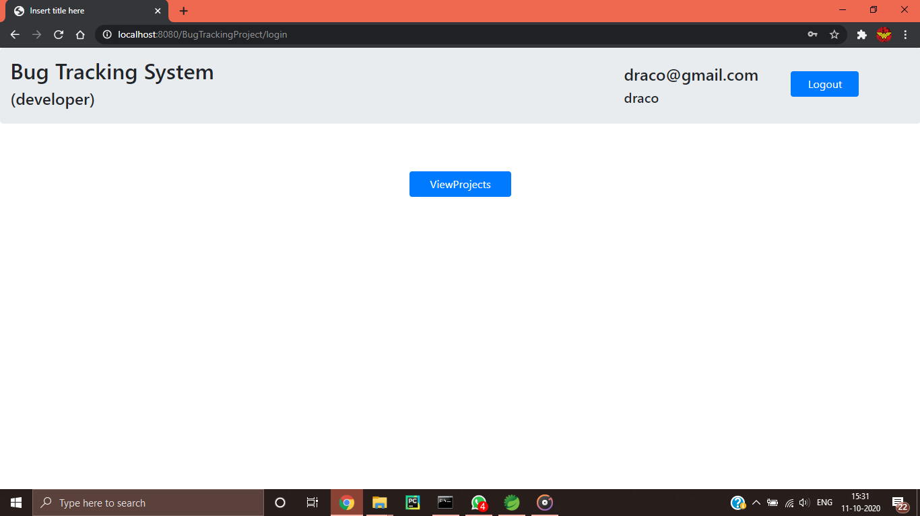

Report a bug page
Project Manager home page
Create a project page
List of projects under the PM
Developer home page
List of projects under the developer

Slide 6
Key Learnings:-
Abhijeet Nitin Raut-”I have learnt how web applications work and also how to work with json data.“
Adrija Ghansiyal-”Throughout the debugging phase, I learnt different styles of handling the same issue. Along with the understanding of the workflow of the application, I understood the importance of teamwork as well.”
Akanksha Shrivastava-”I learnt a lot about github and also got a better understanding of the structure and flow of the project. I also realized the importance of teamwork and collaboration while working on the project.”
Akshay Ramdev-”I understood the importance of following standards and 3-tier architecture while working on the project.”
Ankit D.S Bhadoriya-”Throughout the project, I learnt methods of error handling and the importance of writing robust code and the 3-tier architecture. I also learnt about servlets and inculcated soft skills like collaboartion, problem solving etc.”
Bharadwaj Divate Kondandarama-”I learnt the needs and design of layered architechture and loose coupling in an application. Collaborative approach lead to different and unique ideas which helped in creating optimal solution. “
Dharampreet Singh-”The project gave me a better understanding of developing web applications. Throughout the project, I also realized the importance of collaboration to achieve optimal results.”
Gautami Ravindra Rahane-”The project gave me a great understanding of servlets and JSPs. I was able to implements my learnings from the training.”
Hrishita Bhattacharjee-”The project enabled me to brush up my skills in web development technologies and I also understood the importance of 3-tier architecture and also the importance of teamwork to solve problems.”
Hrushikesh Vitthal Vanga-”I learnt how to handle sessions in servlets and also how to store data in sessions. ”

Slide 7
Thank you

